Slide 1
The choice and impact of metric within Persistent Homology
Ethan Scheelk

Slide 2
We’re skipping past persistent Homology
(you hopefully know it)

Slide 3
What? & Where We’ll Go
An implicit assumption of a metric
But there are a multitude of metrics!
What if we use a different metric? How will this impact the homology?
Introduce the pertinent metrics
Methods
Data Sources & Results
Conclusion

Slide 4
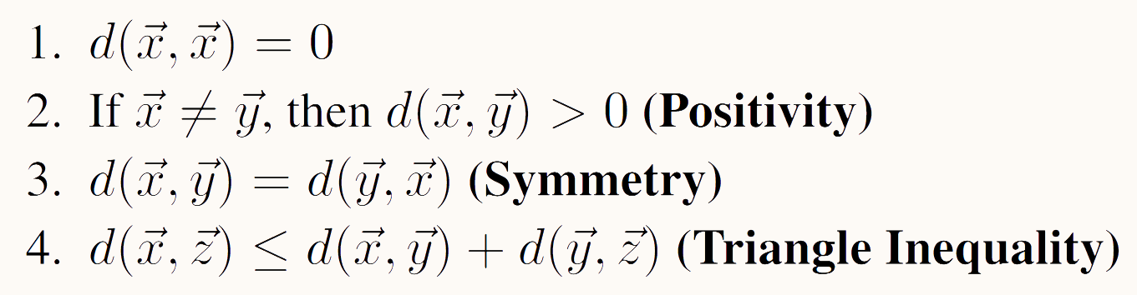
A reminder on metrics

Slide 5
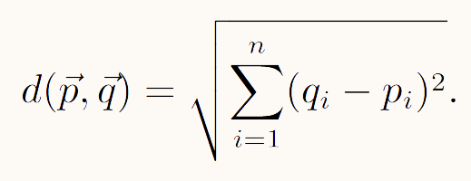

Euclidean

Slide 6

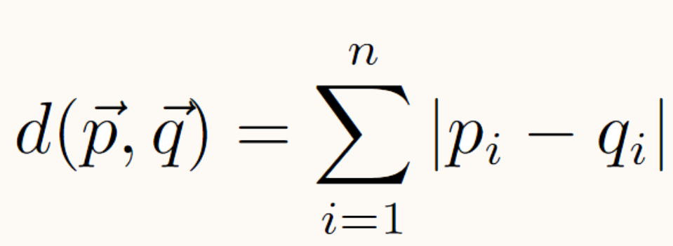
City Block
Aka Manhattan, aka taxicab
Walk along each axis to the next point

Slide 7
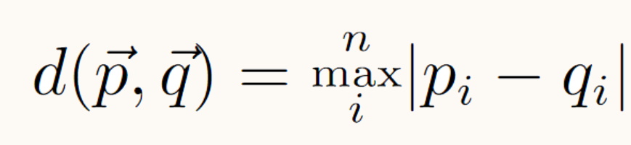

Chebyshev
How many moves it would require a king to move to another spot on the chessboard
Diagonal moves have the same cost as horizontal moves
The farthest you must walk along any axis

Slide 8
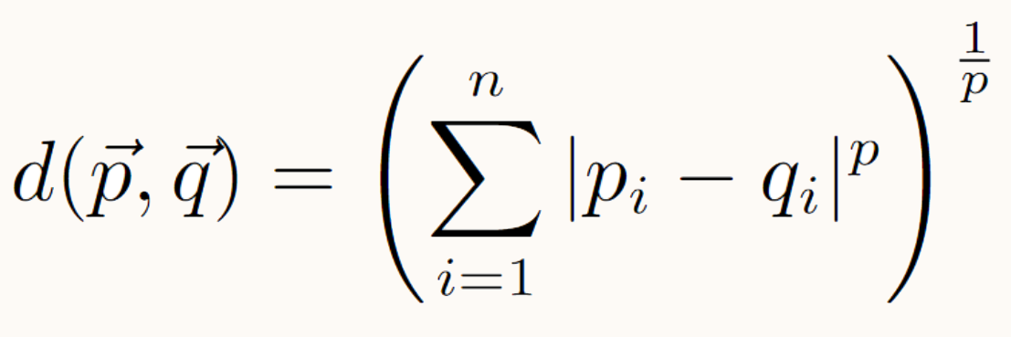
Minkowski / P-Norms
The three already discussed are of this form

Slide 9
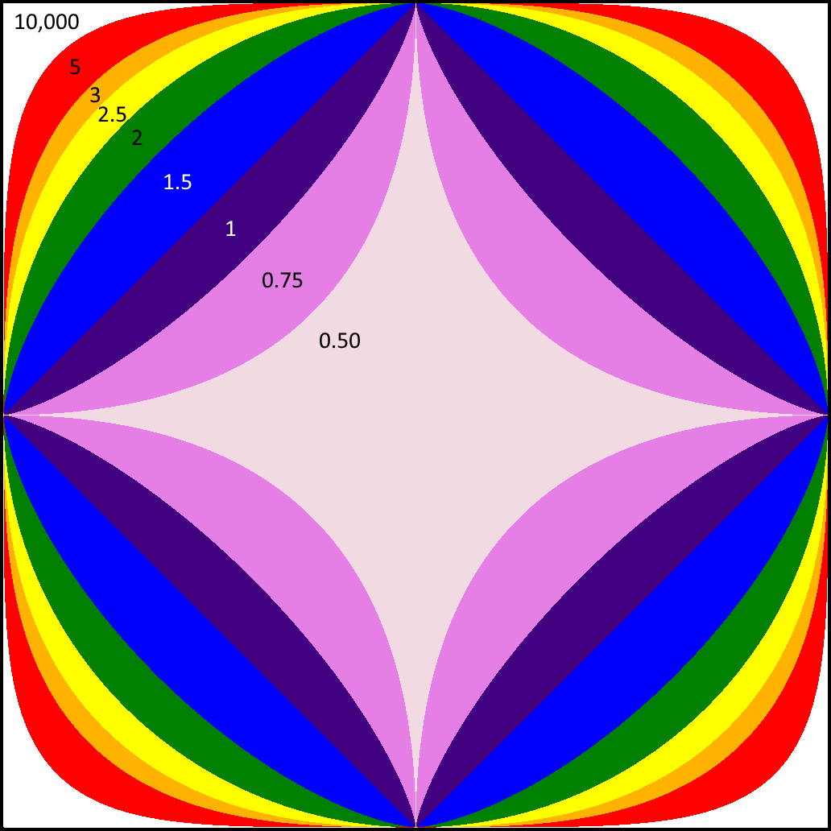

Slide 10
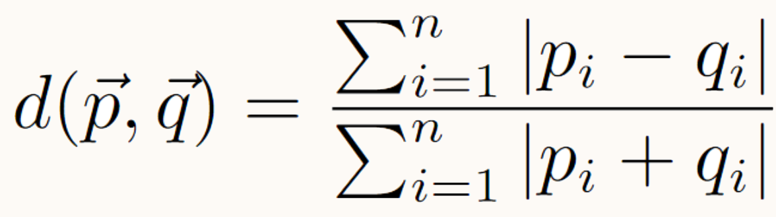
Bray-Curtis
Similarity Measure
If all coordinates are positive, the distance is between 0 and 1
Used as normalization in ecology
Undefined for two zero coordinates

Slide 11
Hamming
For a string, the number of single character modifications to get to another string
For a vector, the number of components that are not equal

Slide 12
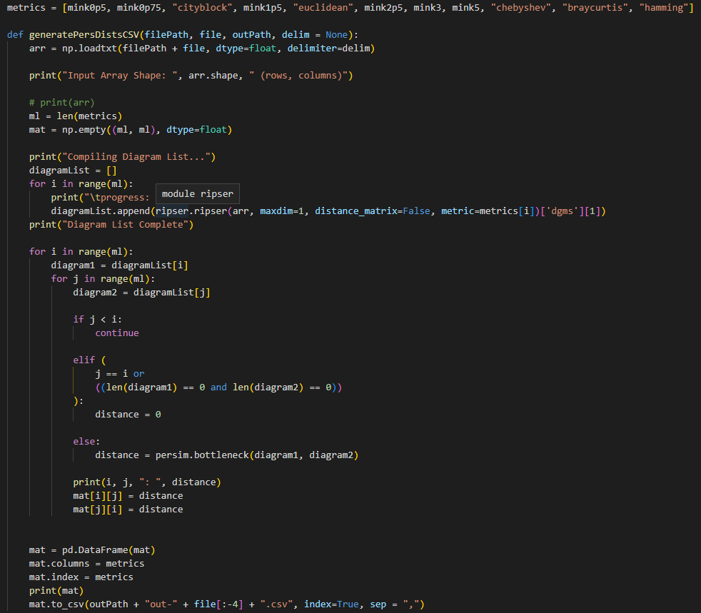
Methods
RIPSER Python package for the persistences
Persim to use bottle neck
Saved to CSV using PANDAS
Graphed using R image()

Slide 13
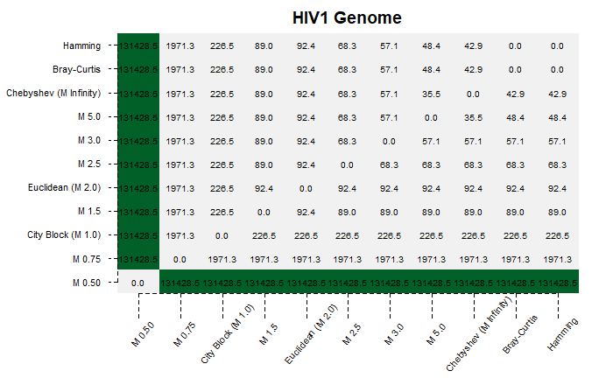
HIV1 Genome

Slide 14
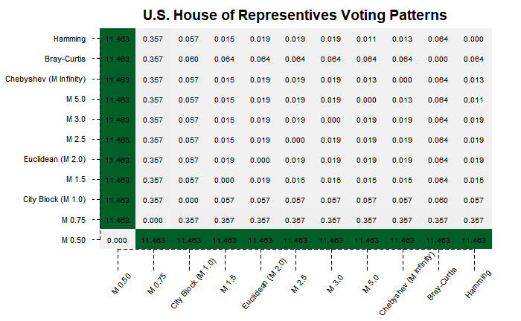
House of Reps Voting Records

Slide 15

Stanford Dragon

Slide 16
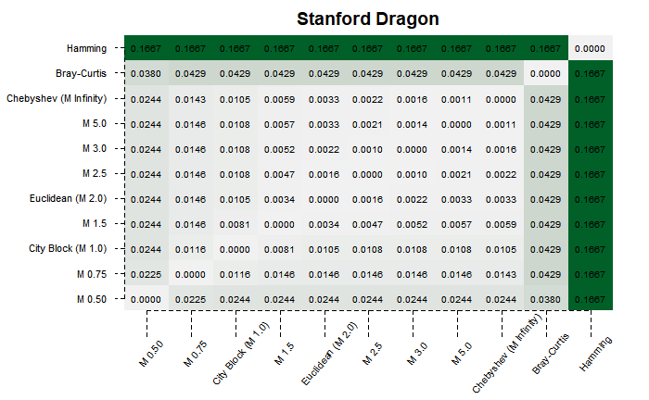
Stanford Dragon

Slide 17
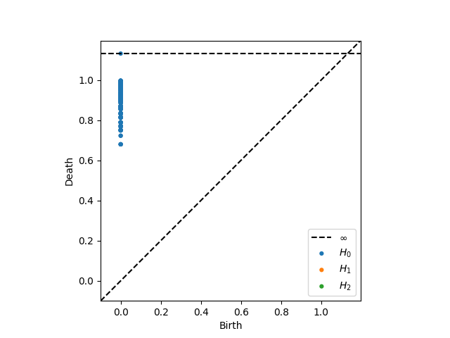
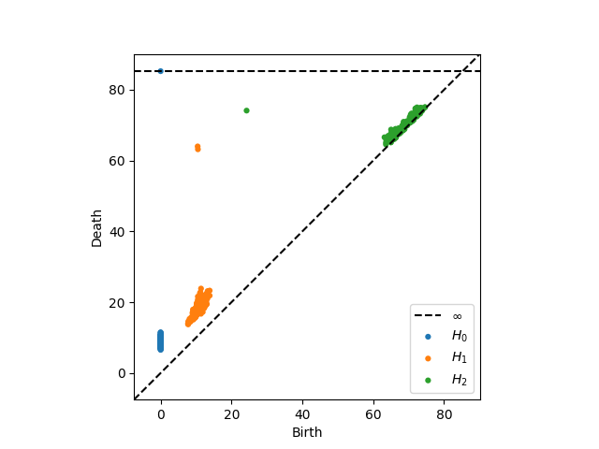
Torus in 400D

Slide 18

Torus in 400D

Slide 19
Conclusion
The results are hard to interpret

Slide 20
Limitations and Future
Bottleneck is just one look at distance between persistences
Look at Wasserstein
It would also be wise to look at how the homology changes as well as the distance it is from other homologies.
More metrics?
Clearly there is no “best” metric, but we’d like to motivate the metric differences a little more

Slide 21
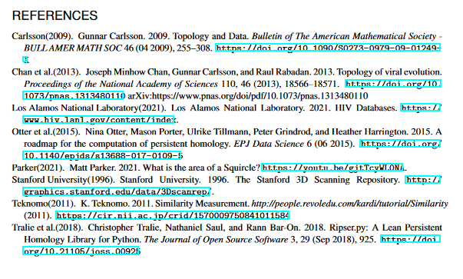
References

